Slide 1
Food Recovery Network
Meeting 1

Slide 2
Icebreaker ☺
Name
Year
Major
Favorite Sweet Treat

Slide 3
Our Exec Board
Peyton Barvinchack- President pb972240@wcupa.edu
Marlene Moore- Vice President/Outreach Chair mm1042958@wcupa.edu
Paul Brower- Secretary pb1008899@wcupa.edu
Sam Shatoff- Treasurer ss979067@wcupa.edu
Erin McGinniss- Media Coordinator em1008201@wcupa.edu
Follow us on Instagram! @wcufoodrecovery

Slide 4
What is FRN?
The Food Recovery Network is a national nonprofit that aims to fight food waste and food insecurity by recovering food and donating it to a nonprofit.
Recovering food is collecting edible food that would otherwise go to waste and redistributing it to feed people in need.
Last semester we worked with the Starbucks on campus and ended up recovering over 100 pounds of food to the West Chester Food Cupboard!

Slide 5
What will the Fall Semester Look Like?
Hopefully make recoveries each week
Depends on if there is food to be recovered
We will get texts on weekdays and have one hour to pick up food from campus
Reaching out to Giant and ACME to make recoveries
More info soon
These recoveries will have sign ups and be more structured
Biweekly meetings
Same place & same time

Slide 6
Food Safety
https://wcupa-my.sharepoint.com/my?id=%2Fpersonal%2Fpb972240%5Fwcupa%5Fedu%2FDocuments%2Fextracurricular%2Ffrn%2Ffrn%20food%20safety%20%2Epdf&parent=%2Fpersonal%2Fpb972240%5Fwcupa%5Fedu%2FDocuments%2Fextracurricular%2Ffrn
Please look over powerpoint before attending a recovery!
To access, go to our page on RamConnect then click files and select meeting 1 powerpoint

Slide 7
Volunteer Hours & Recovery Form
Participating in recoveries earns you volunteer hours through WCU
You can only receive credit if you sign in at a recovery
Google Form pinned in the groupme (leave name, date, and where you recovered from)
Form currently pinned in groupme is for tracking recoveries
Only one person has to fill out tracking form
Everyone in the recovery has to fill out the service hour form

Slide 9
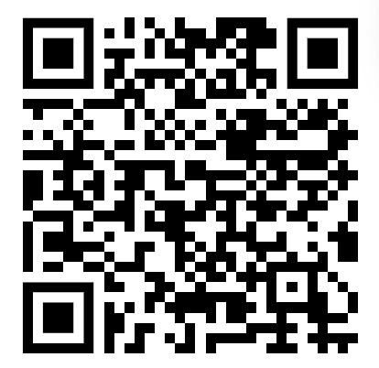
Additional Announcements
VP-No report
Secretary-Recovery Form
Treasurer-No report
Outreach- Position up for grabs
Media- Repost our content (especially meeting info!) on your stories so we can expand our club!
Follow our Instagram @wcufoodrecovery

